Slide 1
Emotions
By Kelly Werner, Ph.D.
Notes:
4:12-4:32 (do more journaling – films, Q & A)

Slide 2
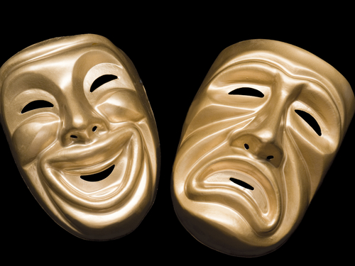
Definition of an Emotion
"Emotions are biologically based reactions that organize an individual's response to important events.
These brief reactions have a
physiological response,
subjective experience, and
expressive behavior.”
-Levenson, 1994
Notes:
Go ahead and just think about what you experienced there – and what is an emotion to you?
A definition that the leading emotion researchers in the world use is…
Emotions are reactions we have to things that have some meaning or importance to us in the world. They are a full on biological and physiology response that organize us to have a specific behavior expression, subjective experience and physiological response.
Definition: Positive Emotions let us know we are moving towards our goals; Negative emotions let us know we are moving away from our goals. Emotions are often created by a thought assessing whether we are moving toward or away from goals – and each have a physiological signature in the body, a subjective felt experience, a behavioral display on our faces & bodies, and urges/action tendencies are recruited.

Slide 3
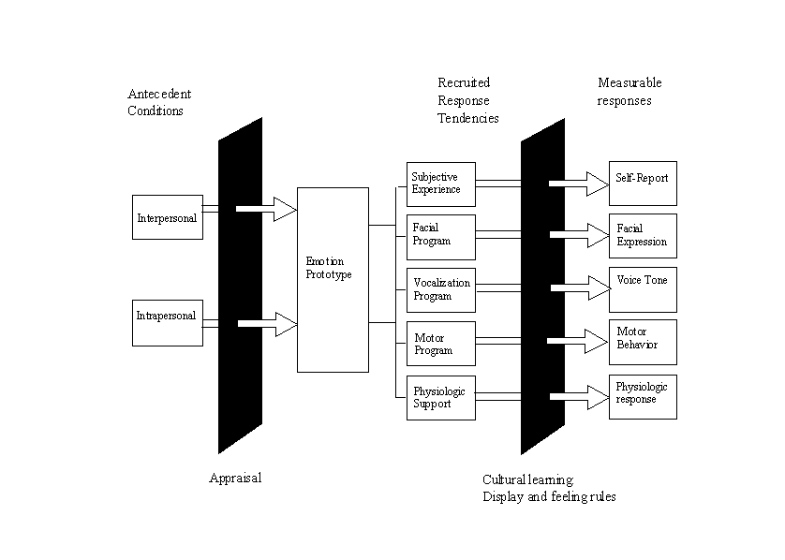
Emotional Response
Recruited Tendencies
Stimulus
Response
Stimulus
Interpretation
Choice
Levenson & Gross, 1995
Notes:
Interpretation --- unconscious, conscious

Slide 4
Emotion vs. Feeling
Body
Mind
Notes:
Emotions can be conscious or unconscious – going so quickly
Emotions researchers in general think that emotions are hardwired biological reactions that we may be aware of or not. And that feelings are the conscious awareness of these reactions. Feeling = conscious representation of an emotion
Here are some quotes:
"Emotions are biologically based reactions that organize an individual's response to important events. These reactions are brief (seconds, not hours), and have a physiological response, subjective experience, and expressive behavior." -Levenson, 1994
"Feelings are when we are consciously aware of the subjective experience of emotions." -Lazarus 1960
"When we are afraid of something, our hearts begin to race, our mouths become dry, our skin turns pale and our muscles contract. This emotional reaction occurs automatically and unconsciously. Feelings occur after we become aware in our brain of such physical changes; only then do we experience the feeling of fear." -Damasio

Slide 5
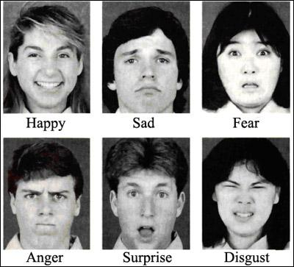
6 basic emotions
Notes:
Paul Ekman that guy in the left in the photo – traveled around the world studied 30 cultures and found that there were 6 different emotions.
Each have their own distinct facial expressions.

Slide 6
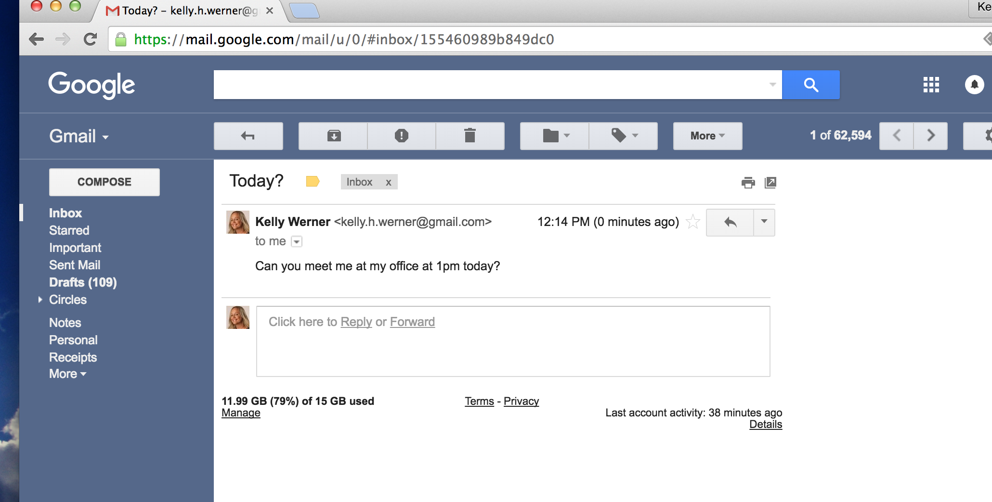
Notes:
Can you meet me at my office at 1pm today – now just stop and think about whether you
Think back to a different boss that you’ve had in the past

Slide 7
Interpretation makes a difference…
Stimulus
Interpretation
Emotion
Response
worry, loose focus
“I’m doing poorly!”
Fear
“Can you meet at my office at 1pm today?”
“She values me.”
Happy
fully engage with work
Notes:
Interpretation influences how you response – from a place of personal power and positivity – or not…

Slide 8
Wisdom of Emotions
Sadness
“There has been a loss”
Fear/Anxiety
“Danger” “Threat”
Anger
“Someone is taking advantage”
Joy
“This is good!”
Disgust
“That is offensive!”
Shame
“There’s something wrong w/ me”
Guilt
“I did something wrong to you”
Notes:
What do you think this emotion is trying to tell you?

Slide 9
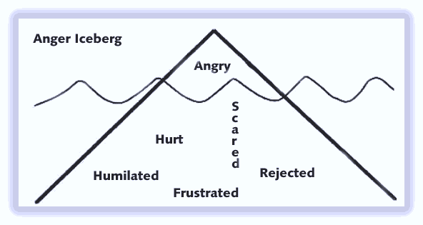
Primary vs. secondary emotions
Notes:
A lot of times when someone is angry – espically if the anger response last for more than a few minutes – it is a 2ndary emotion. And there was actually another emotion there first.
Pain + resistance = suffering
Vulnerable emotion + judgment/blame = anger
Give an example

Slide 10
Why detect emotions in the body?
Respond vs. React
Decision Making
Get to Primary Emotion
Notes:
In our mindfulness based EI teaching, it is important to catch ourselves being angry before we act
Catch ourselves being angry before we act – between stimulus and response there is a space (emotions are creating our behavior when we are not consciously aware – client Chris – angry at work – walking – he noticed his body and didn’t yell at the person on the sidewalk)
Informs decisions (Dan Goleman’s story – lawyer)
I’ll illustrate this with an example

Slide 11
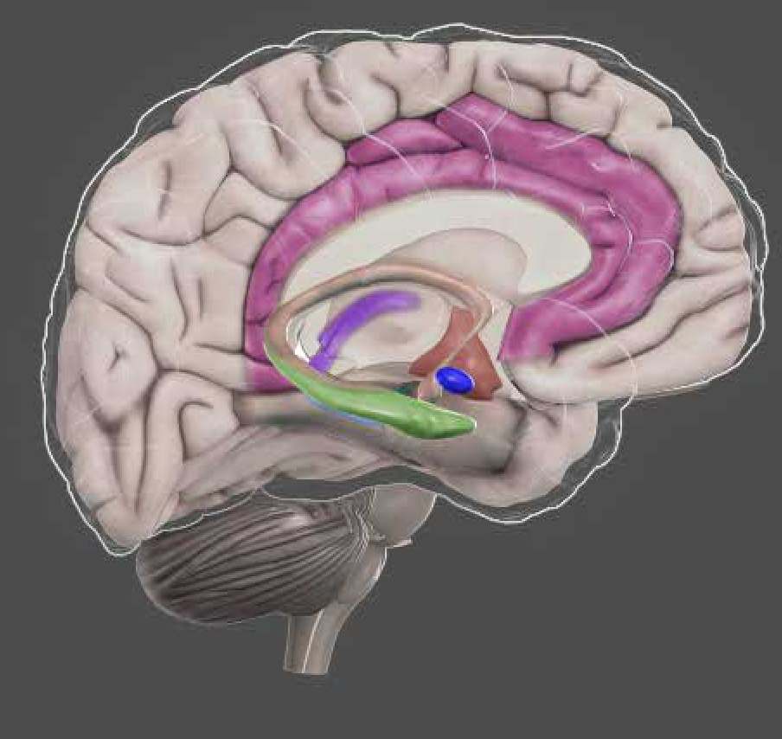
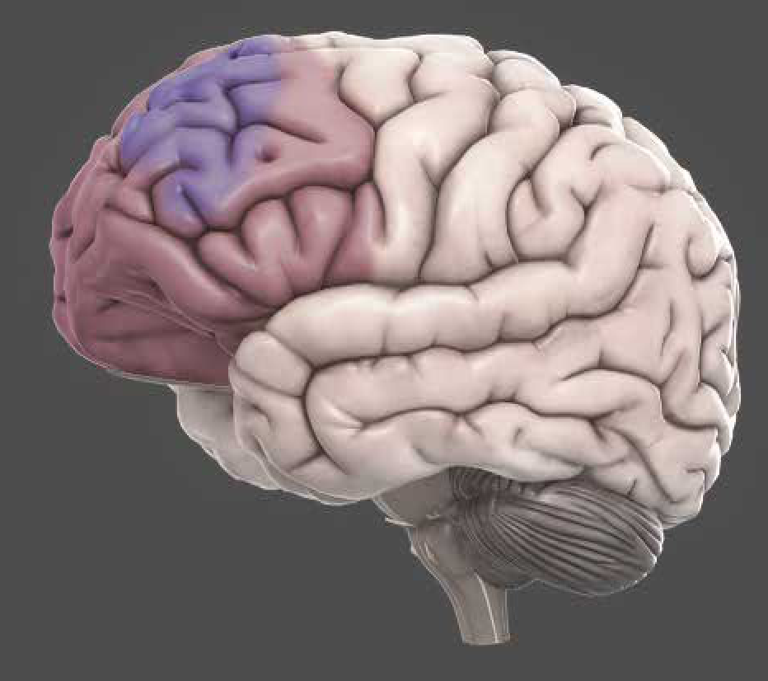
Emotional Intelligence
Emotional Brain (Limbic System)
Thinking
Brain (Prefrontal Cortex)
Notes:
Root of emotion – know what an emotion is, importance of interpretation in creating an emotion, there is wisdom in emotions, why detect them at the level of the body
Define what real mindfulness based emotional intelligence looks like:
We are present and conscious of the current moment, open to whatever comes our way, response flexibility, presence to emotions, compassion, attunement, interconnection – gold standard of what we want to be doing with our attention, emotion, interpersonal stuff & compassion.
We are balancing on the current moment, in our hearts, allowing cognitive, emotional & interpersonal experiences to touch us deeply and then move through.
With mindfulness, we are just a little less tossed around by running away from or crushing what feels bad. We’re less compelled to indulge in our desires and excesses for what gives us a temporary high. Instead, we see with greater clarity just how blue the sky is on a beautiful day and we see and feel the depths of our hearts being pierced when we’ve experienced a meaningful loss. And somewhere in that fuller human experience, we connect and tap into a deeper source of motivation and choice that is more aligned with our integrity, our values and ethics, and our authentic essence. As we are in more contact with the depth of ourselves, we can then connect with the humanity in others.

Slide 12
Hijack
Prefrontal Cortex
Amygdala
Hijack
Notes:
Snake & rope example
What are examples of how you get triggered?

Slide 13
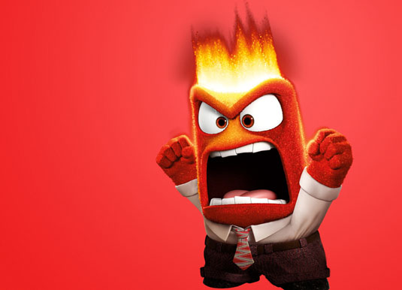
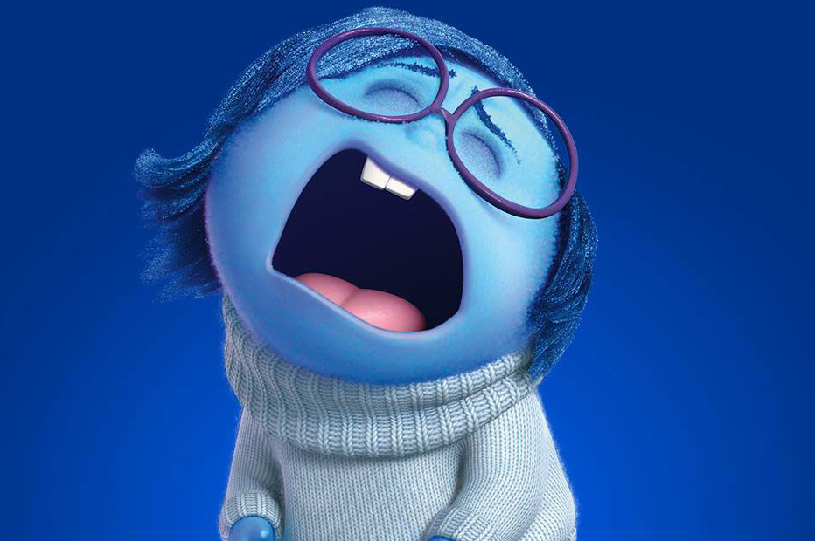
Stimulus
Schema
Ways we get triggered…
Interpretation
Emotion
Response
Mistrust:
You will be harmed
through mistreatment
“They are intentionally trying to block me”
Push back with edge & frustration
“Your program is not a priority right now”
Emotion Deprivation:
Your needs for emotional support will not be met
“I feel mis-understood and overlooked”
Give up
Notes:
Now just imagine that you brought this to your program – and they told you they don’t want it
a 3rd person might be neutral – and not have a negative emtoion – take it in stride and think --

Slide 14
Working with Triggered Emotions
Recruited Tendencies
Stimulus
Response
Stimulus
Observe, Allow, Self-compassion
Attention (Shift off stimulus or thoughts to the breath/senses)
Interpretation
Choice
Reframe Bolster Negative Positive
Choose a wise response
Notes:
Mindfulness facilitates all of the ER responses – because you first need to be self-aware before you choose a response
Emotion regulation refers to strategies that can influence which emotions arise and when, how long they occur, and how these emotions are experienced and expressed.
Shift attention off of self-elaboration and judgement
Don’t look at twitter feed.

Slide 15
Suppression
Decreases positive emotion
Physiological cost
Impairs memory performance
Feel less social connection
Listener is stressed
Werner & Gross, 2010
Notes:
Some of my work at Berkeley and Stanford studied this…
What it is – deeper explanation
Research behind it – really talk about research supporting this
Suppression is more effortful
Decreases positive emotion experience
Exacerbates physiological activation
Deplete cognitive resources—impairs memory performance
Social connection is down as there is a discrepancy between inner experience and outer suppression
Inauthenticity can lead to negative feelings about the self – more difficult to establish emotionally close relationships
While interacting with a person doing suppression – subjects experience more stress (not in tune with the flow of interaction)

